Slide 1
Differences between Going to vs Will

Slide 2
Diferencias
Going to:
Hablar del futuro
1. PLANES
We’re going to London next month.
I’m going to write a book this year.
2. PREDICCIONES
It’s going to rain tonight.
That team is going to win.
Will
Hablar del futuro
1. PROMESAS
I’ll always love you.
I won’t tell your secret.
2. DECISIONES ESPONTÁNEAS
I am hungry; I will make lunch. (Tengo hambre, voy a hacer el almuerzo)
-I am cold; I will put on a jacket. (Tengo frio, voy a ponerme una chaqueta)

Slide 3
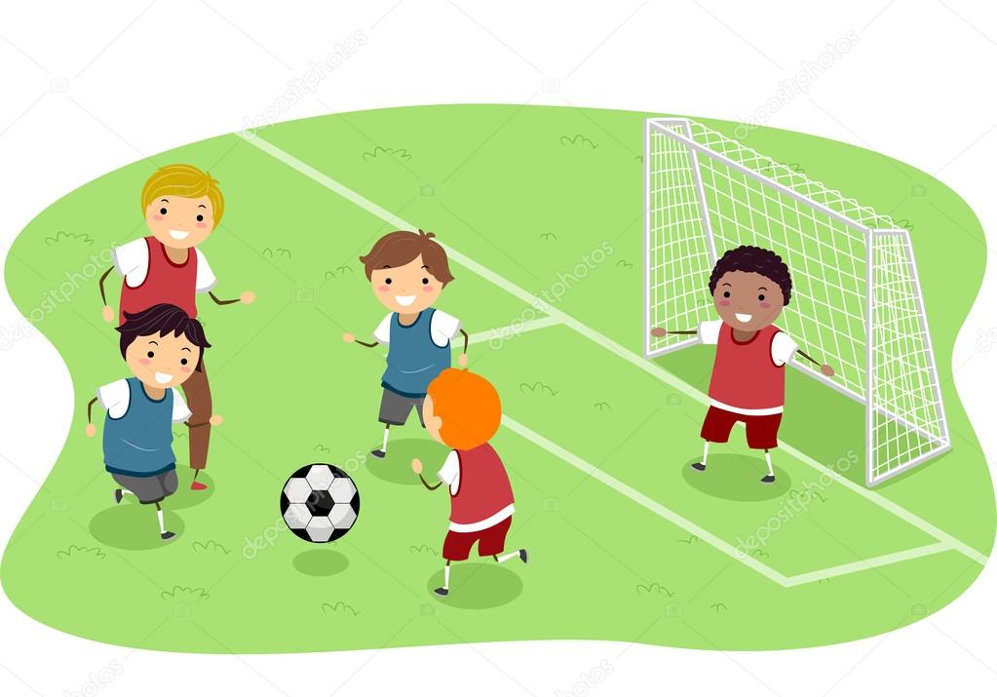
Nosotros jugaremos futbol la otra semana
Nosotros vamos a jugar futbol la otra semana

Slide 4
Will
+ Sujeto + Will + Verbo base + Complemento
Nosotros jugaremos futbol la otra semana
+ We will play football the following week
- Sujeto + Will not/ Won’t + Verbo base + Complemento
- We will not play football the following week
? Will + Sujeto + Verbo base + Complemento?
Will we play football the following week

Slide 5
Going to
+ Sujeto + To be + Going to + Verbo base+ Complemento
Nosotros vamos a jugar futbol la otra semana
+ We are Going to play football following week
- Sujeto + To be + not + Going to + Verbo base+ Complemento
- We are not/ aren’t Going to play football following week
? To be + Sujeto + Going to + Verbo base + Complemento?
? Are we Going to play football following week?

Slide 6
Examples
Yo te ayudare con la tarea
I will help you with homework
Ustedes van a estudiar ingles el otro año
You are going to study English next year
Nosotros jugaremos el proximo partido de futbol?
We will play the next football game?

Slide 7
Examples
Ustedes van a montar bicicleta la otra semana
You are going to ride a bike the other week
Yo no voy a corer en las siguientes olimpiadas
I'm not going to run in the following Olympics

Slide 8

Evaluation

